Slide 1
Emotion Recognition
Implementing Computer Vision and Machine Learning techniques to identify a persons’ emotion.

Slide 2
Emotion Recognition
One of the first and foremost challenges in Computer Vision and Machine Learning.
Various out-of-the-box solutions exist on Microsoft Azure, AWS ML Suite etc etc.
We will be using OpenCV, an open-source computer vision framework for Python.
Main objective of this project is to accurately display the identified emotion without much latency and with minimal error.

Slide 3
Model Workflow
A high-level flowchart of the proposed model workflow.

Slide 4




System Overview
Labelled Training Data
Cropped, Grayscaled Image of just the face
Feature Extraction
Trained Model

Slide 5
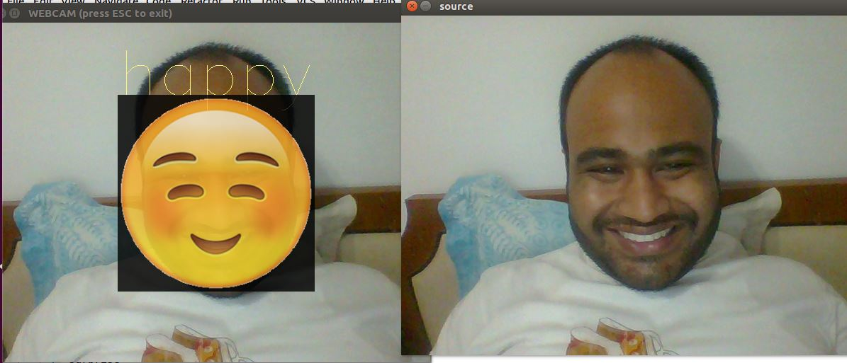

System Overview
Continuous Input via Webcam
Automatic Feature Extraction
Recognized Emotion
Output
Trained Model

Slide 6
Working of the Model
How the model extracts, identifies and acts upon emotions

Slide 7
Normalizing the Input
Database comprises of 220 images of which 80% form the training set.
Both the training data and the input stream need to be normalized to a particular size before any operation is applied.
Script image_normal.py does that job for us.
Step 1: Find Faces (Using Haar features based Cascade Classifier)
Step 2: Convert to Grayscale
Step 3: Resize to 350x350
Step 4: Add Gaussian Blur(5,5)
All jpg images located under the path <data/source_images> will automatically be normalized

Slide 8
Training the Model
Once we have normalized labelled images for our training, we use prepare_model.py to train our model
We are making use of two different models for this project- A Fisherfaces model and an Ensemble Fisherface Model.
Fisherfaces works off the principle of PCA with Linear Discriminant Analysis.
The Ensemble Model employs 5 different models that come up with one emotion output per model. The mode of all these emotion outputs is identified as the final output.

Slide 9
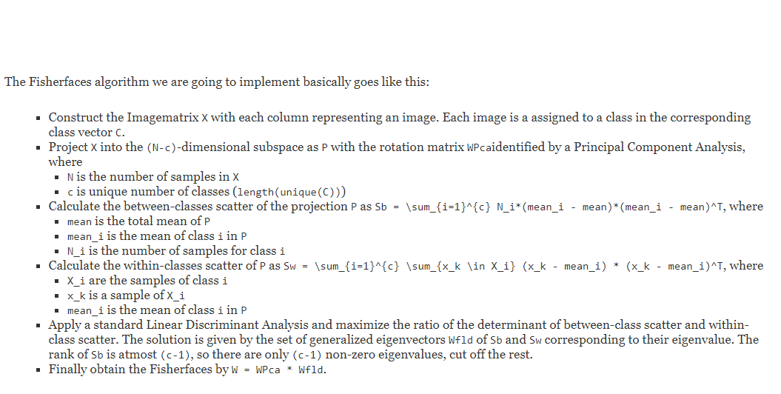
Fisher Face Algorithm

Slide 10
Eigen Faces Vs Fisher Face
Fisher face is vital when there is a variation in terms of illumination and Facial expressions
Being that the only difference the operational aspects remain same.
Eigen Face uses PCA where as Fisher face uses LDA
PCA chooses vector in two levels the one with most variation followedby the second most orthogonal vector
LDA chooses vectors based on how the classes are defined.

Slide 11






Displaying the Output
Every emotion output is mapped to an emoji located in the </data/graphics> folder and identifyies among the six facial expression .
Depending upon the final output of a model, we are superimposing the corresponding emoji to the identified face in the input
This dynamic output will also display the text of the identified emotion simultaneously.

Slide 12
Demo
How our program works.

Slide 13
Pros and Cons
Fisher Face Algorithm
Very Accurate with relatively lesser training data also
Averse to high variance between faces.
Speed of computation is higher
Possible Improvements
Instead of using an algorithm that maps the two-dimensional input patterns to a vector, we could use 2DLDA, a tensor extension of LDA with Fisher Faces.
This directly extracts the proper features from the image matrices based on Fisher’s LDA.
Some advantages and disadvantages of the models we chose.

Slide 14
Pros and Cons
Ensemble Model
Requires a relatively higher amount of training data.
Results can get skewed very easily. Intra-model variance poses a big issue.
Speed of computation is lower, thus leading to considerable lag.
Possible Improvements
Multithreading the model runtime procedures to make the model more efficient.
Some advantages and disadvantages of the models we chose.

Slide 15
Questions?

Slide 16
Further Readings
http://www.bytefish.de/blog/fisherfaces/
http://docs.opencv.org/2.4/modules/contrib/doc/facerec/facerec_tutorial.html
Arumugam, Devi & Purushothaman, S. (2011). Emotion Classification Using Facial Expression. International Journal of Advanced Computer Science and Applications - IJACSA. 2. . 10.14569/IJACSA.2011.020714.
Eigenface based recognition of emotion variant faces

